Slide 1
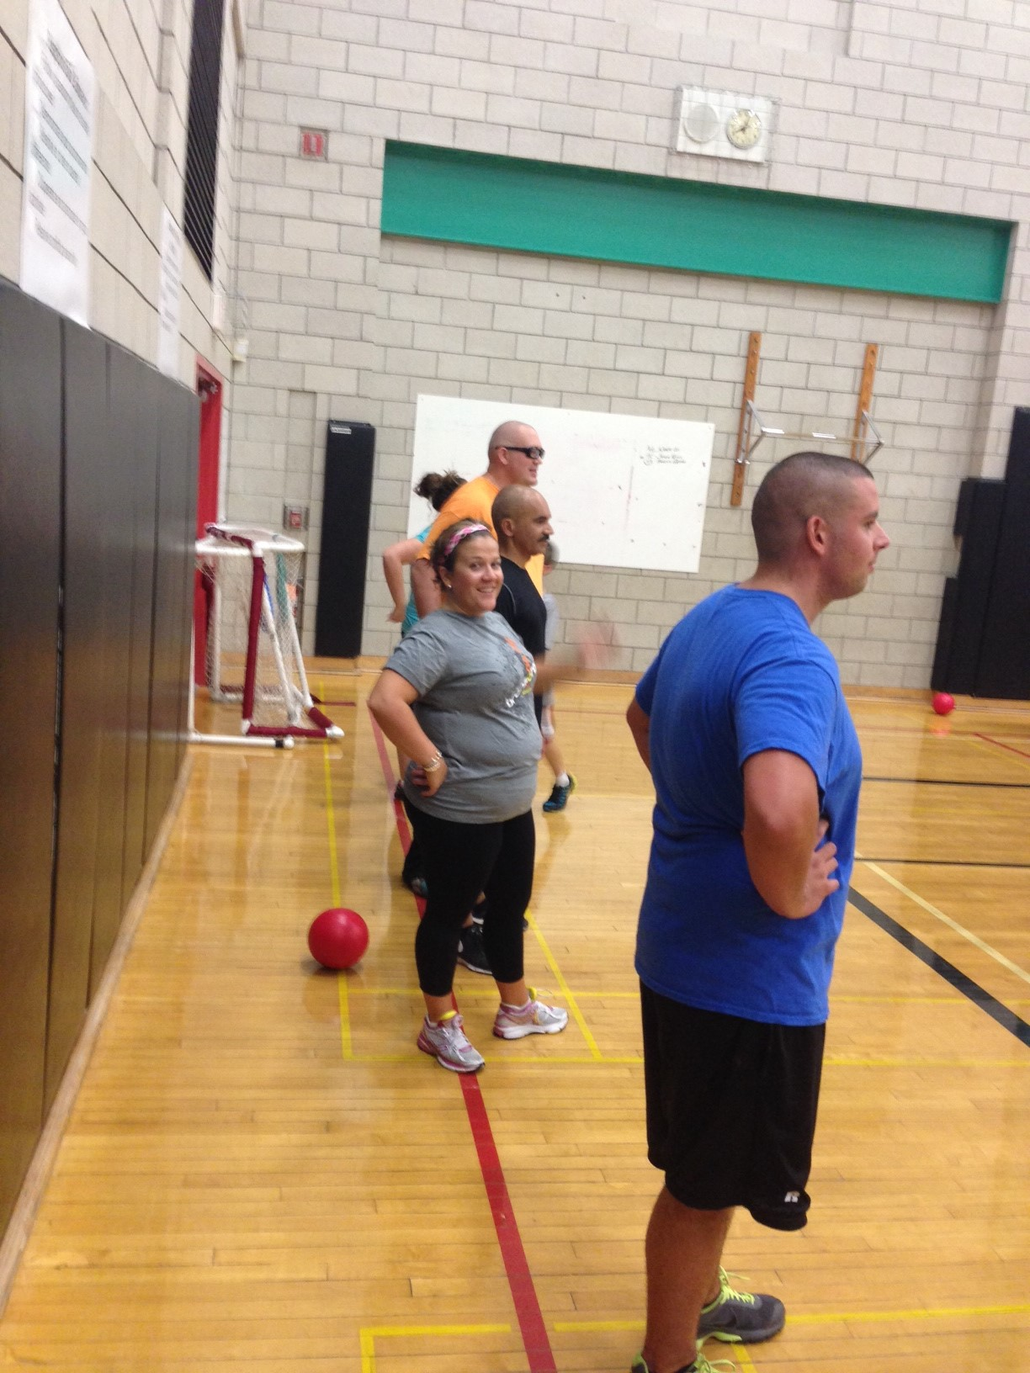
ADULT DODGEBALL LEAGUE 2014
Register now: www.bristolrec.com or in person at Parks & Rec office
Call 860-584-6160 for ?’s
Ages: 18+
$30 for free agent
$175 for team of 8-10 players
Bristol parks and recreation
Wednesday Nights 7-9pm
Chippens Hill Middle School Gym
8 weeks of action!!!
October 1nd-November 19th
INCLUDES FREE
T-SHIRT

